Slide 1
RFID Analysis Using Apache Hadoop and Spark
Beshoy Magdy - Hesham Adel - Omar Sourour

Slide 2
Introduction
What is Big Data?
Introduction to Hadoop
Introduction to Apah

Slide 3
Task 1: Analysis Using Hadoop
Task Description
Input Format
Date, Time, Event Type, Number, Name, Access, Relay
Output Format
The number of departures and entrances per day.
The number of departures and entrances per employee.
The duration of stay per day of each employee in the company.
Program Flow
Program Structure

Slide 4
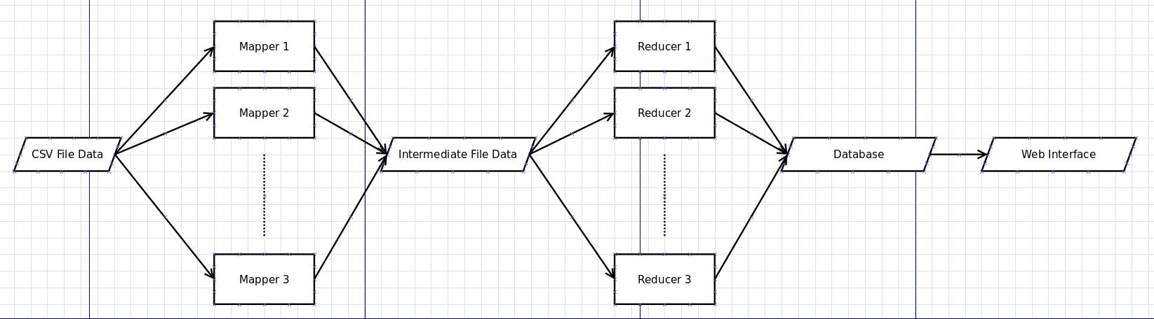
Task 1: Analysis Using Hadoop
Program Flow

Slide 5
Task 1: Analysis Using Hadoop
Program Structure
Map Function
Reduce Function
Web Interface

Slide 6
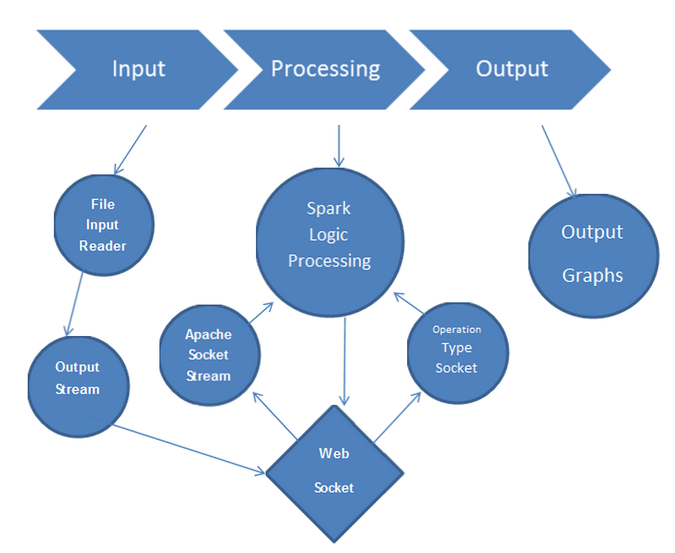
Task 2: Analysis Using Spark
Task Description
Program Flow

Slide 7
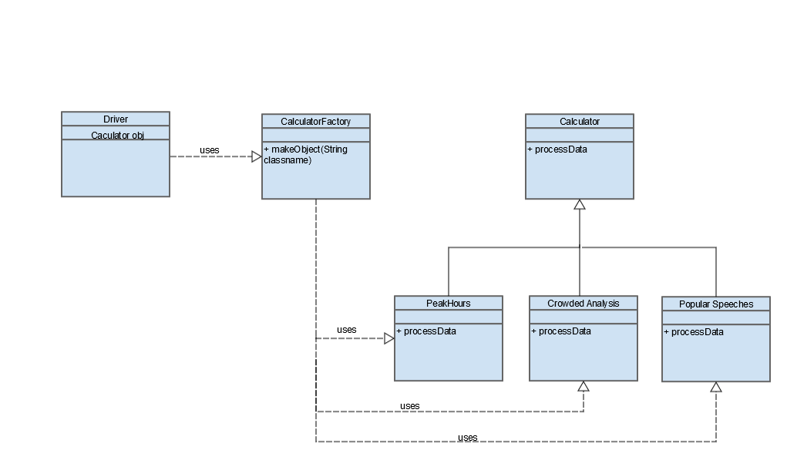
Task 2: analysis Using SparK
Program Structure

Slide 8
Thank You

